Slide 1

Introduction
What is GTA 5?
Fifth main installment in Rockstar’s Grand Theft Auto series.
Released in 2013, still hugely popular over a decade later.
Genre: Action-adventure, open-world.
Platform: PS3, PS4, PS5, Xbox 360, Xbox One, Xbox Series X/S, PC.

Slide 2
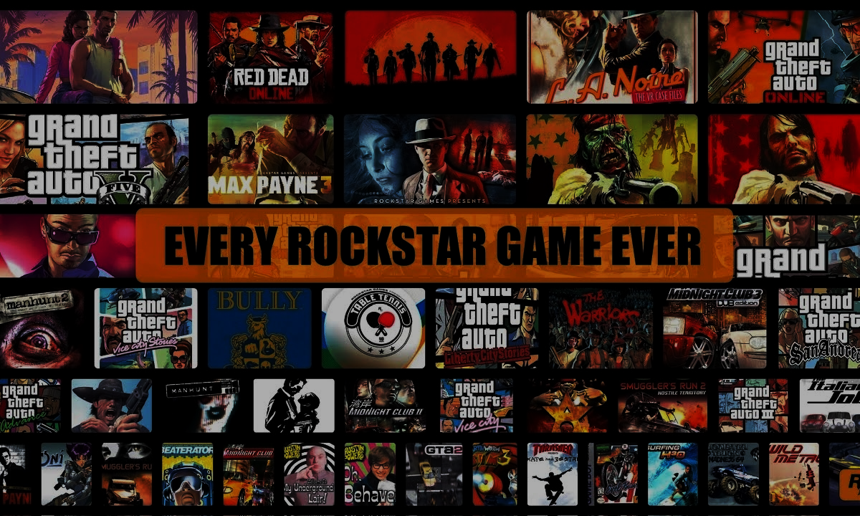
About Rockstar Games
Developer and publisher of GTA 5.
Known for high-quality, narrative-driven open-world games.
Other titles: Red Dead Redemption, Max Payne.

Slide 3
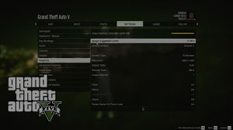
Game Setting
Location: Los Santos — fictional city based on Los Angeles.
World: Massive, detailed open world including city, desert, mountain, and ocean environments.
Design: Inspired by Southern California.

Slide 4

Main Characters
Michael De Santa: Retired bank robber, lives a dysfunctional suburban life.
Franklin Clinton: Ambitious street hustler looking for opportunities.
Trevor Philips: Unpredictable, violent ex-military pilot and criminal.
Unique for letting players switch between characters in real time.

Slide 5
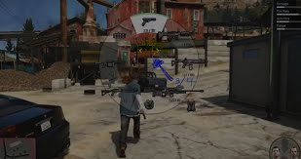
Gameplay Features
Open-world exploration, driving, shooting, and missions.
Heists: Coordinated multi-character missions.
Mini-games: Golf, tennis, yoga, scuba diving, etc.
Realistic NPC interactions and world dynamics.

Slide 6

GTA Online
Multiplayer version launched shortly after GTA 5.
Custom character, free-roam, missions, heists, businesses.
Ongoing updates: New vehicles, properties, events.
Major revenue driver for Rockstar.

Slide 7
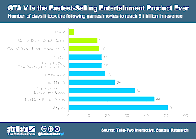
Commercial Success
Over 185 million copies sold (as of 2024).
One of the highest-grossing entertainment products of all time.
Estimated revenue over $7.5 billion.

Slide 8
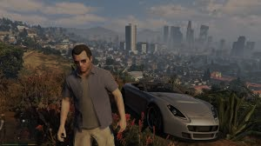
Graphics and Technology
Advanced graphics for its time; improved in enhanced editions.
Realistic lighting, weather, and character animation.
AI-driven NPC behavior and environmental realism.

Slide 9

Cultural Impact
Sparked debates on video game violence and freedom.
Referenced in memes, music, pop culture.
Popular in modding and roleplay communities (e.g., FiveM).

Slide 10

Legacy and Continued Popularity
Still trending a decade after release.
Huge modding community.
Set the standard for open-world game design.
Set the stage for GTA 6.

Slide 11

Conclusion
GTA 5 remains a landmark in gaming history.
Blended storytelling, innovation, and massive open-world freedom.
Anticipation is building for its successor, GTA 6.

